Slide 1
IDENTIFYING AUTHORSHIP OF ANCIENT HEBREW TEXTS
Jie Sun
Sun Kim
Nellie Ponarul
Rowana Ahmed
Group 21
Notes:
Sun: Hello, we are group 21, and our presentation is on identifying authorship of ancient Hebrew texts.

Slide 2

Who wrote the Bible?
Problem: True number of authors is unknown
Our goal: Determine how many distinct styles are in the Torah, which may correlate to different authors.
Notes:
Sun: As an ancient text that goes back thousands of years, the exact authorship of the Hebrew Bible is unknown. Our goal is to identify the different writing styles, and thus potential authors, that exist in the first five books of the Bible, also known as the Pentateuch, or the Torah in the Jewish faith tradition.

Slide 3
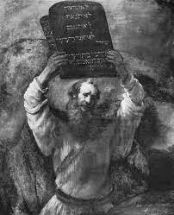
The Pentateuch
The Pentateuch (Torah) is comprised of first five books of the Bible which are generally attributed to Moses
Genesis, Exodus, Leviticus, Numbers and Deuteronomy
Notes:
Sun: The Pentateuch consists of the books of Genesis, Exodus, Leviticus, Numbers and Deuteronomy. In the Judeo-Christian faith traditions, the authorship is attributed to prophet Moses

Slide 4
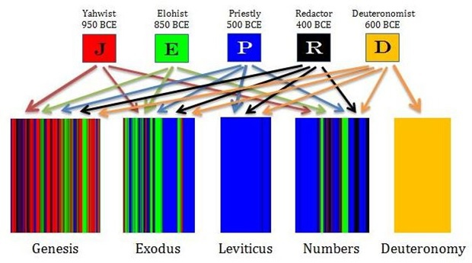
Documentary Hypothesis
Biblical experts’ theory explaining the origins and compositions of the Pentateuch
Notes:
Sun: However, scholars have hypothesized that there are actually five different authors of the Torah. This is called the documentary hypothesis. While the exact persons of the authorship are unknown, scholars have proposed that the Torah is sourced from 4 different documents, which were later then compiled by a series of redactors.

Slide 5
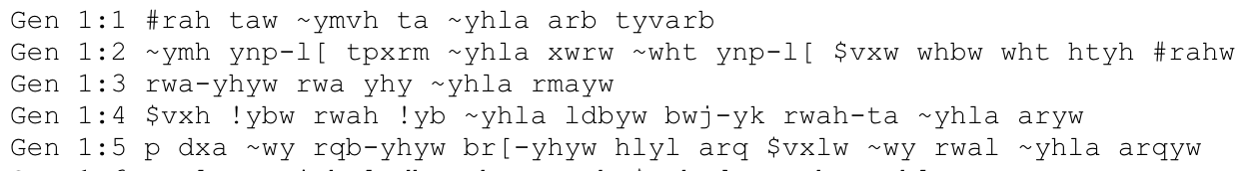
Some Challenges
Since true authors are unknown, we cannot use a supervised approach to find our answer
SOTA models like BERT are not trained on Ancient Hebrew
Latin encoded Ancient Hebrew
Notes:
Sun: Since the true authors are unknown, we cannot use a supervised learning approach. We also cannot use state-of-the-art models like BERT that have not been trained on ancient Hebrew.

Slide 6
Our Approach
Based on approach by Koppel and Akiva & validated with artificial texts:
Author I
Text
Verse Embedding
Gen 1:1
Gen 1:2
Gen 1:1 [-0.025, -0.011, -0.002, ...]
Gen 1:2 [-0.035, -0.016, -0.003, ...]
Gen 1:3 [-0.956, -0.047, -0.102, …]
Gen 1:4 [-0.021, -0.017, -0.002, ...]
Gen 1:5 [-0.998, -0.052, -0.092, ...]
Gen 1:4
Author II
Skip Gram (with Hebrew texts)
LSTM (with Hebrew texts)
Bert (with English texts)
Gen 1:3
Gen 1:5
Unsupervised Classification
Spectral Clustering
Hierarchical Clustering
Notes:
Sun: So, our approach will be to create verse embeddings using Skip-gram, LSTM, and BERT. BERT will be trained on the King James Version of the Bible in English. Then, we will use unsupervised classification methods on these verse embeddings, namely spectral and hierarchical clustering.

Slide 7
Texts to Embeddings
Notes:
Rowana:
We compared three different embedding methods to see which performs best.

Slide 8
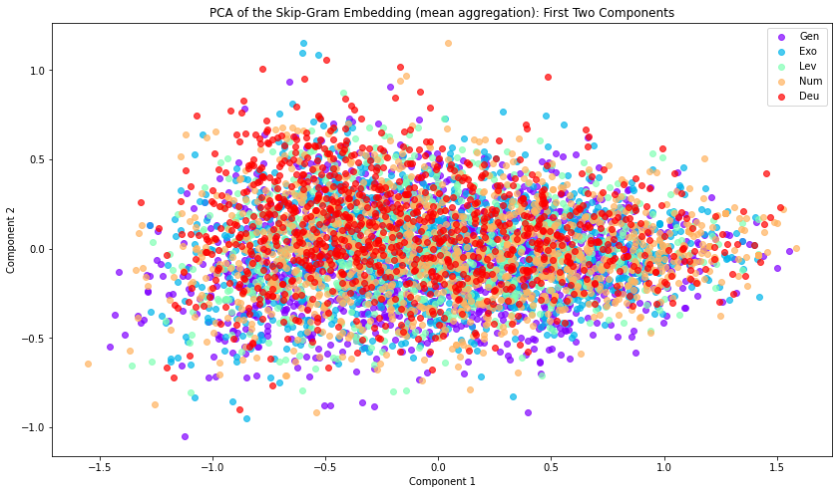
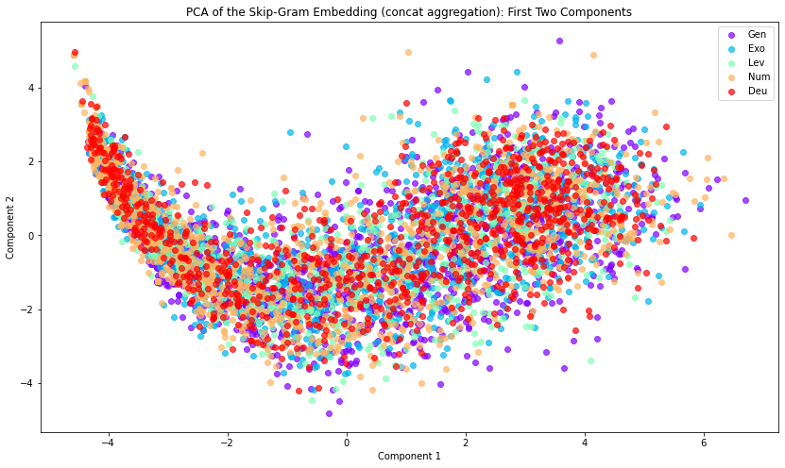
Texts to Embeddings - Skip Gram
Generate word level embeddings using skip-grams (window = 2) to capture word order and unique phrasing patterns that could differentiate each author’s writing style
Comparison of Mean & Concatenation Aggregation Methods
word 1
Skip gram word level embeddings need to be aggregated to verse level embeddings.
word 2
word 3
word 4
Mean Verse
Concatenated Verse Embedding
Word order maintained, high dimensional
Notes:
Rowana 1:15
The first embedding is based on skip grams with a window size of 2. By considering positive and negative cases, we hoped to capture unique phrasing patterns that could differentiate each author’s writing style.
Once we had the word level embeddings, our next challenge was to aggregate these to verse level embeddings. First we tried taking the mean across the words per verse. However, this method loses word order information within the verse, and so we also considered concatenating the words to achieve the verse level embeddings. As you can see, in the PCA plots, the concatenated embedding has more structure and clustering patterns when visualized along the first two components.

Slide 9
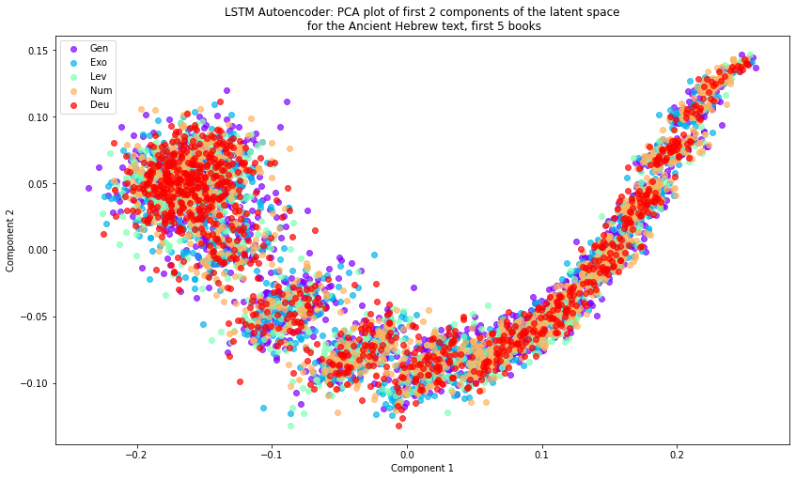
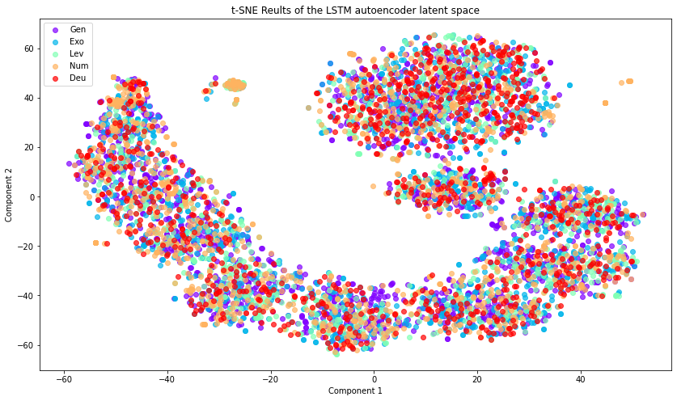
Texts to Embeddings - LSTM Autoencoder
Embedding: Latent Space from an autoencoder
Used one Bidirectional LSTM layer for the encoder and decoder with 20 units in each
76% of variance in data explained by first two principal components
Notes:
Nellie: Next we trained an LSTM autoencoder with one bidirectional LSTM layer as the encoder and decoder. We’ve visualized the first two principal components on the left which capture 76% of the explained variance in the data, and the first two tSNE components on the right, which should evidence of some local neighborhood structures that include verses from all five books.

Slide 10
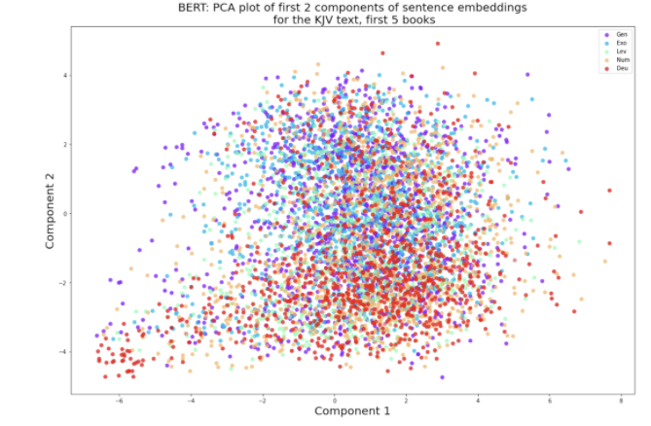
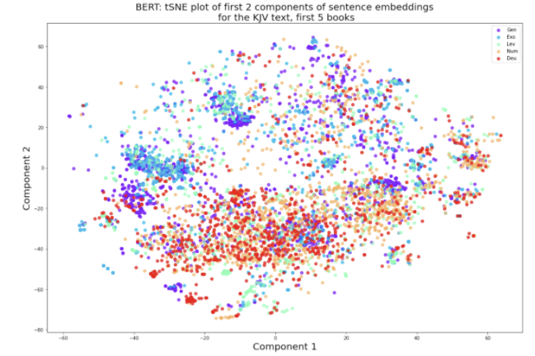
Texts to Embeddings - BERT
BERT allows us to use transfer learning in NLP.
As BERT is mostly trained on the English language, we used the King James Version of the Hebrew Bible, as a meaningful comparison against the embeddings on the Hebrew text
Easier to pick up the linguistic features
10% of variance in data explained by first two principal components
Notes:
Jie. A third embedding is created by BERT. As BERT is mostly trained on English, we used the King James Version of the Hebrew Bible. This allows us to pick up the linguistic features of the texts, in english.TSNE plots shows that the English embeedings indeed suggest multiple authors for the Pentateurch

Slide 11
Embeddings to Unsupervised Classification
Notes:
Jie. We will further investigate the authorship classification with our embeddings.

Slide 12
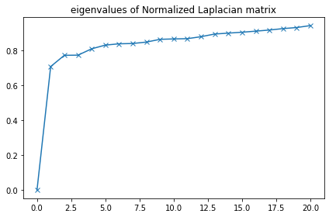
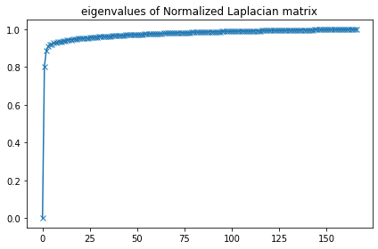
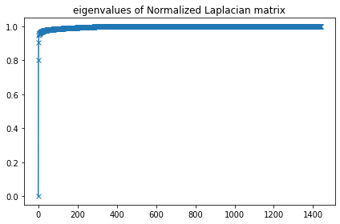
Spectral Clustering Background
Improves efficiency of clustering by considering reduced eigenspace of the normalized Laplacian matrix
L_{norm} = I - D⁻¹W, where W is a similarity matrix and D is the diagonal matrix summing the rows of W
Spectral clustering provides a heuristic to determine an appropriate k to use for clustering.
Obadiah, Amos, &
Ezekiel
Obadiah
Obadiah & Amos
Notes:
Rowana
To identify the number of unique authors, we compared 2 different unsupervised techniques. The first method is spectral clustering. For some quick background, spectral clustering reduces dimensionality by considering the eigenspace of the normalized Laplacian matrix to cluster in. Compared to clustering in the original data space, this improves the efficiency of the clustering method used, which in our cases was k-means.
Selecting an appropriate k is a challenging part of unsupervised learning, but spectral clustering provides a heuristic to determine the number of clusters. The method suggests selecting k based on the number of smallest eigenvalues of the Laplacian that are below a point of convergence.
In the plots below, we can see what this looks like in practice when clustering books with single authors. As we augment our data to include additional books, we can see that with each additional book, there is a corresponding eigenvalue present below the point of convergence.
have some examples of what this looks like for a few texts with known authorships. When we cluster verses in Obadiah, which is written by a single author, we see that there is only one eigenvalue below the point at which all other values converge. This corresponds to a single cluster, which seems to make sense. When we look at the eigenvalues for a text composed of Obadiah & Amos, so two different authors, we see two corresponding eigenvalues below the point of convergence. And when we augment the text with a third book, we see a third eigenvalue below the point of convergence.

Slide 13
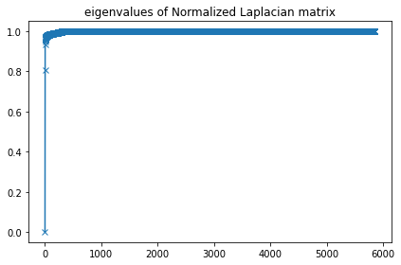

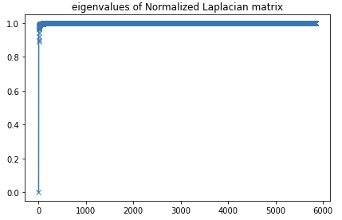
Spectral Clustering
Skip-gram (cosine)
K = 3 (or 2)
LSTM (euclid)
K = 4
BERT (euclid)
K = 2 (or 3)
Notes:
Rowana
Using this heuristic on the first 5 books, we found that the skip gram embedding indicates there are 2 major authors and 1 minor author, the LSTM embedding indicates 4 authors, and BERT indicates 2 major authors and 1 minor author.

Slide 14
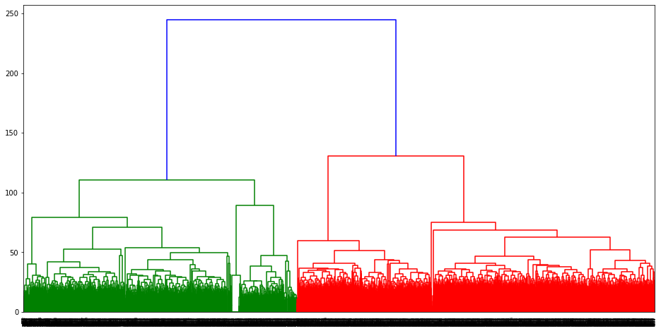
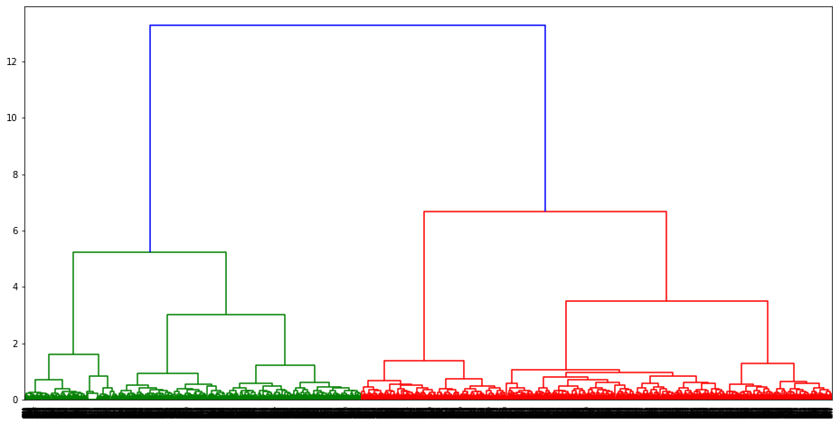
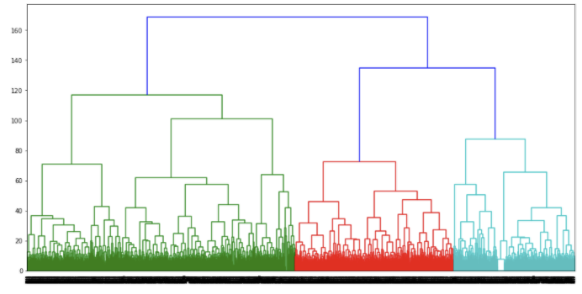
Hierarchical Clustering
Skip-gram
2 well separated clusters
LSTM
4 somewhat well separated clusters
BERT
2 well separated clusters, and 1 cluster can potentially be further split into 2 clusters
Notes:
Rowana
We also compared our spectral clustering results with hierarchical clustering methods, and found similar results. Skip-gram however seems to indicate only two authors here.

Slide 15
Validation of Embedding & Clustering Process
Notes:
Nellie 1:15? Next we’ll talk about some of the ways we validated our embeddings and clustering labels.

Slide 16
Evaluation of Embeddings - Supervised Label Prediction
Idea: Assess how well embeddings capture stylistic elements that would be unique to an author by training a FFNN on labeled verses
For each embedding type:
Take ~1000 verses from Genesis
Assuming the documentary hypothesis labels (JE, P, D, & R) are true, train a FFNN on a portion of the verses
Test the prediction accuracy on the remaining verses not used to train
Dense Layer
Number of authors + softmax activation
Output Layer
Embedding
Notes:
Nellie: To evaluate the strength of the relationships between the embeddings, we built a simple feed forward network through which we could pass our embeddings whatever author labels we had and get the test set accuracy. We first used this method to generate test prediction accuracies between each embedding and the labels in the documentary hypothesis.

Slide 17
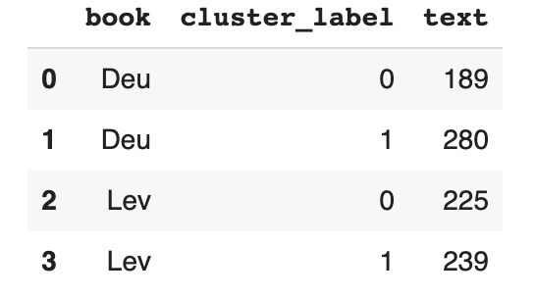
Evaluation of Embeddings & Clustering -
Artificial Text Generation
Idea: Create a document written by multiple known authors and determine how well our embeddings capture the stylistic differences between authors and clustering method groups verses
Process:
Take n number of books from the Bible
For each iteration
Take a section from one of the books of the Bible
Append to artificial text
Train embeddings on mixed text and perform clustering to get predicted number of authors
Compare clustering labels to assumed authors
Notes:
Nellie: We then used a similar feed forward network to test the ability of each embedding to predict labels we knew - we randomly combined two books from the Bible for which we were confident in the author and determined how well each embedding could predict the known authors.

Slide 18
Overview of Validations
Embedding | Embedded Text | Artificial Text FFNN Test Set Accuracy (2 authors) | K Means Accuracy (2 authors) | Ward’s Method Clustering Accuracy (2 authors) | Documentary Hypothesis Validation Accuracy (4 authors)
Skip Gram | Ancient Hebrew | 71% | 53% | 53% | 60%
LSTM | Ancient Hebrew | 58% | 53% | 52% | 60%
BERT | King James Bible Translation | 88% | 61% | 56% | 56%
Artificial Text Generated using Deuteronomy and Leviticus (2 authors)
Notes:
Nellie: Here is an overview of the accuracy scores for each embedding with each type of validation we performed. While since there are 2 authors in each example prev BERT NUMBERS .61 .56 .88 .56

Slide 19
Results Summary & Discussion
Notes:
Jie. To summarize,

Slide 20
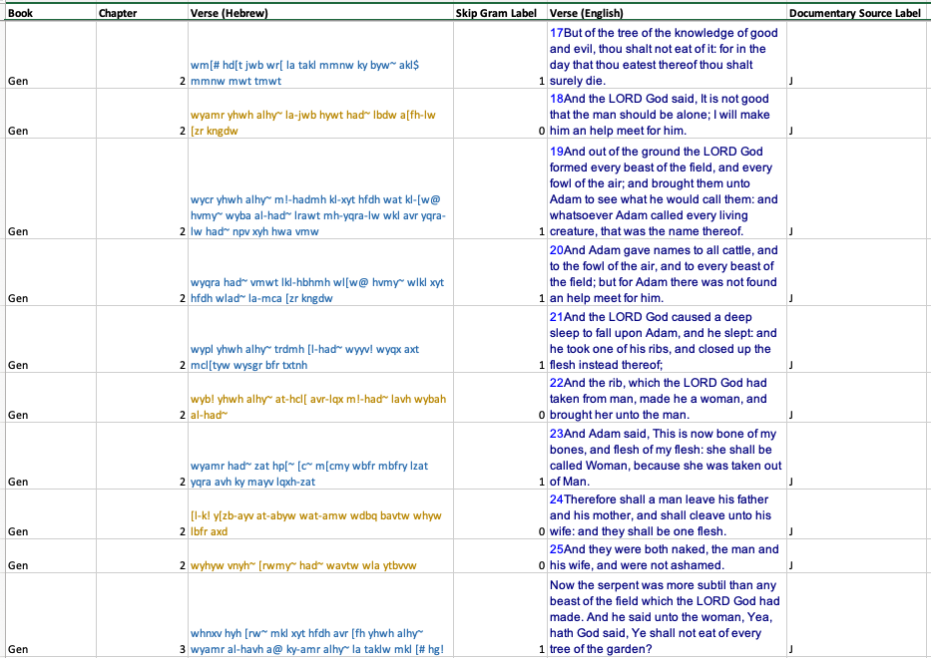
Number of Authors for Books I - V Predicted by Each Embedding
SkipGram: 3 authors
LSTM Autoencoder: 3 authors (possible 4th minor author)
BERT: 2 authors (possible 3rd minor author)
Notes:
Different methods provide different, but similar, estimations on the number of authors for the first 5 books. We have also generated the predictions at the verse level, and compared that against the documented biblical references. These results can be used for future researches.

Slide 21
Strengths
Multiple methods to create embeddings, with both Hebrew and English text.
Novel classification technique (i.e. spectral clustering).
Comprehensive validation methods: artificial text, k-means, Ward’s method clustering.
Sensible outcome for the number of authors
Notes:
Using multiple methods to obtain embeddings and validate the results made our study more robust. In particular, spectral clustering allows us to derive convincing number of clusters using eigenvalues.

Slide 22
Limitations
Limited corpus
Embeddings cannot differentiate the differences in content or style, thus the classification could be attributed to either different authors, or different contents, or both.
Notes:
However, the ancient hebrew corpus is still limited, thus impacting the quality of our embeddings. In addition, since the embeddings represent overall features of the text, we cannot tell if the classifications are attributed to either different authors, or different content, or both.

Slide 23
How can we make our models better?
Train on a larger corpus of Ancient Hebrew (if it exists)
Inform embeddings with language-specific context
Koppel and Akiva used manual synonym embeddings
Can build a RNN model to see what word or phrases are activated for a specific classification
Notes:
To improve, we can train on a large corpus if possible. Or, build models to see which word or phrases are activated for a specific classification. Traditional ways of informing embeddings with linguistic context should be incorporated to make more sense of how embeddings work.

